Slide 1


Germany
Berlin Airbnb
Noor Ali

Slide 2


Problems and Questions
Where in Berlin to invest . This analysis reveals demand, pricing, and revenue potential | Where is demand the strongest?
Where in Berlin to invest . This analysis reveals demand, pricing, and revenue potential | What are the average nightly prices by room type?
Where in Berlin to invest . This analysis reveals demand, pricing, and revenue potential | Where is the competition highest?

Slide 3

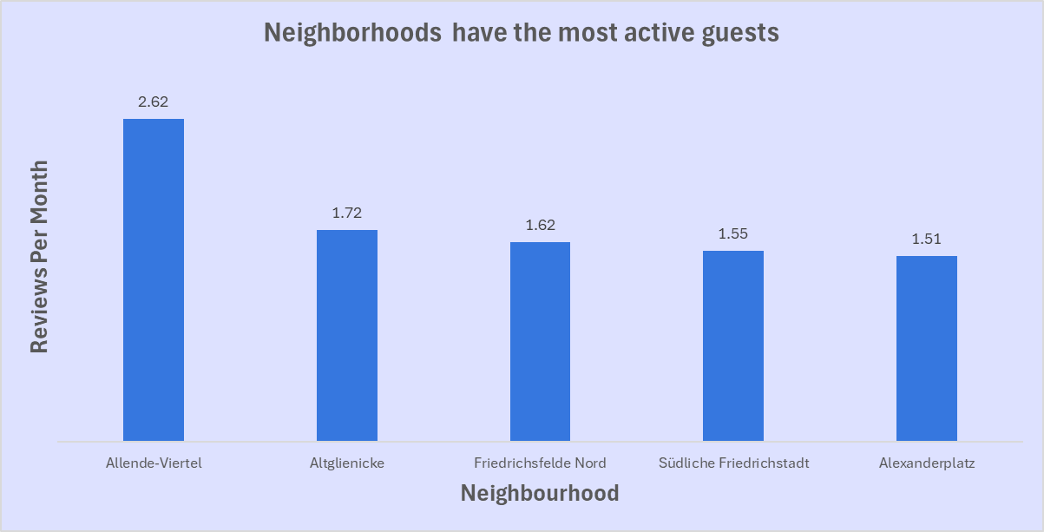
Demand is strongest in residential neighborhoods (Allende-Viertel, Altglienicke).
central Berlin (Alexanderplatz, Südliche Friedrichstadt)
Where is demand the strongest?

Slide 4

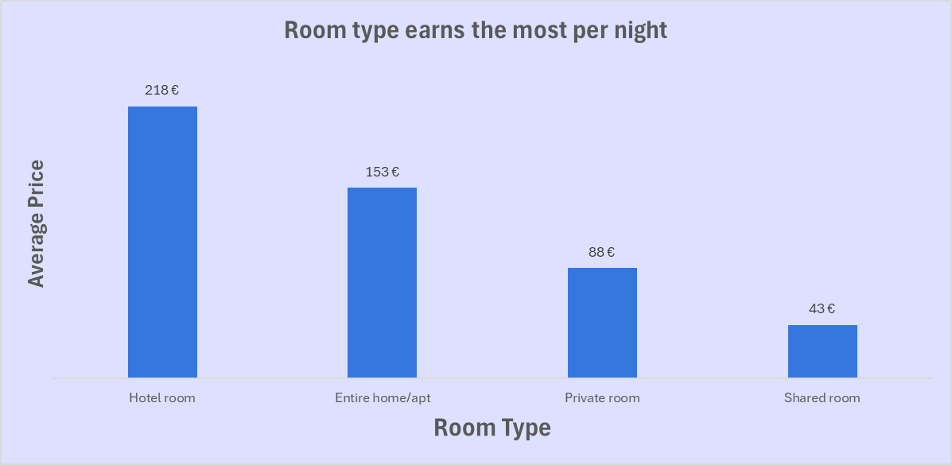

What are the average nightly prices by room type?
Entire apartments are profitable and balanced category.
Shared/private rooms target budget travelers
hotel rooms cater to premium demand

Slide 5



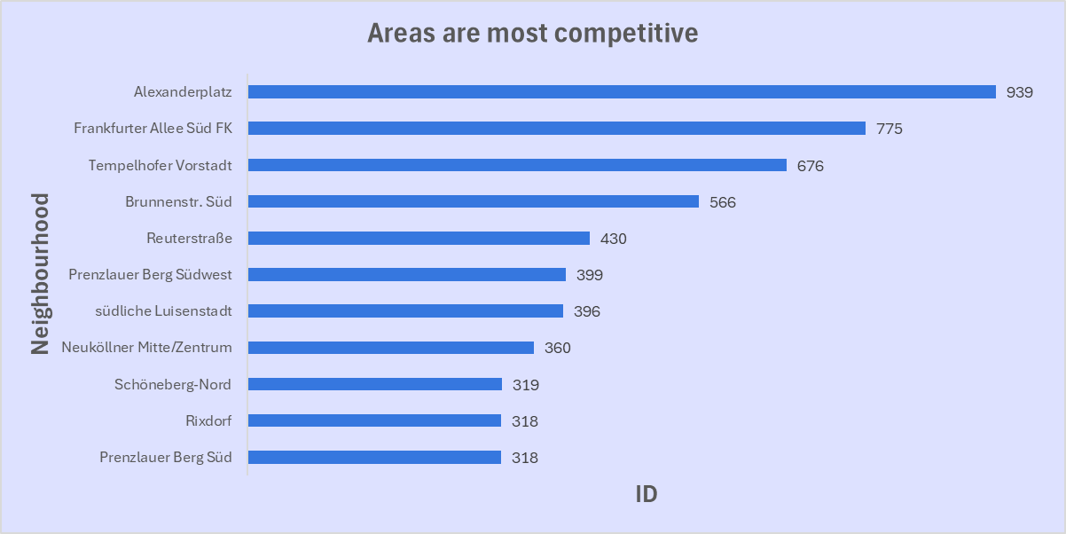
Where is the competition highest?
Alexanderplatz has the highest density, showing strong competition.

Slide 6

Invest near the city center
Alexanderplatz, Regierungsviertel, Südliche Friedrichstadt. These areas combine high demand, strong pricing.
Choose Entire home/apt listings
Balanced demand, moderate competition, and good price levels.
Recommendations
Avoid overly competitive areas
like Alexanderplatz unless offering unique amenities or pricing strategy, since competition is intense.

Slide 7


Thank you for your time!

